Slide 1
Grievance Redressal Portal for Institutions
Database Systems Engineering and Distributed Backend Development (25CS1302E)
Team: Arnav Chitikena & Harshith Maddineni

Slide 2
Grievance Redressal Portal for Institutions is a web-based system designed to provide a centralized, transparent, and efficient platform for managing grievances raised by students and other institutional users. In many educational institutions, complaints related to academics, infrastructure, information technology, examinations, hostel facilities, transportation, and other campus services may be handled through manual or disconnected processes, making it difficult to track complaints, assign responsibilities, and monitor their resolution.
The proposed portal aims to simplify this process by providing role-based access for students, staff, and administrators. Students can securely log in, submit grievances by selecting appropriate categories and priorities, and track the status of their complaints. Staff members can view grievances assigned to them, update their progress, and provide responses or resolutions. Administrators can monitor all grievances, assign complaints to appropriate departments or staff, manage users and categories, and analyse grievance statistics.
Abstract

Slide 3
Problem Statement
Educational institutions receive grievances related to academics, infrastructure, IT, examinations, hostels, transportation, and other campus services.
Many complaints are handled through manual or disconnected channels such as verbal communication, emails, forms, or messaging platforms.
This makes it difficult to track complaints, assign responsibilities, monitor progress, and ensure timely resolution.
A centralized and transparent grievance management system is therefore required.

Slide 4
Currently, grievances in many institutions may be handled through different and disconnected channels, such as:
Paper/application forms
Emails
Verbal communication
Messaging platforms
Direct communication with staff
Existing System

Slide 5
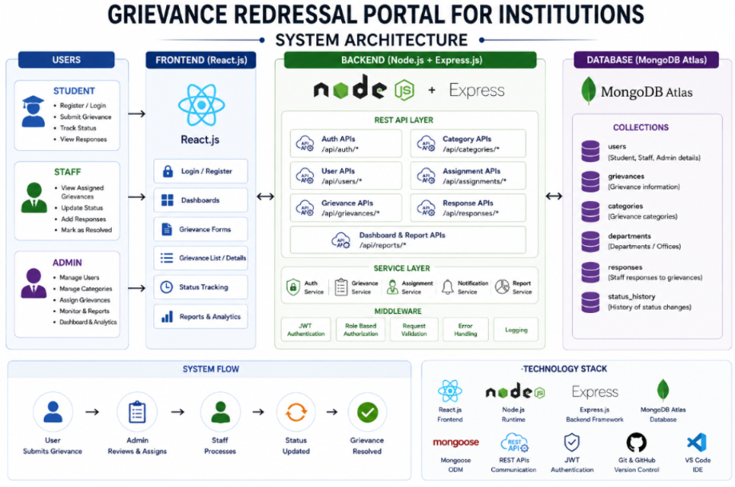
PROBLEM
↓
Student submits
↓
System records
↓
Admin assigns
↓
Staff handles
↓
Staff updates
↓
Student tracks
↓
Problem solved
Proposed System

Slide 6
Technologies Used
React.js — Frontend development
Node.js — Backend runtime environment
Express.js — Backend framework and REST API development
MongoDB Atlas — NoSQL database
Mongoose — ODM for MongoDB and Node.js
REST APIs — Communication between frontend and backend
VS Code, Postman, Git & GitHub — Development, testing, and collaboration tools

Slide 7
Centralized management of institutional grievances
Easy submission and tracking of complaints
Improved accountability through assignment and status tracking
Greater transparency for students and administrators
Faster and more organized grievance resolution
Structured storage and retrieval of grievance records
A scalable digital platform for institutional grievance management
OUTCOMES

